Slide 1

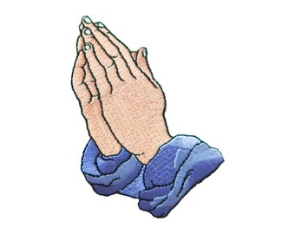
St Mary’s Catholic Academy
–
Prayer Guide

Slide 2
Our Prayers
Age phase | 5–7 (KS1) | 7–9 (Lower KS2) | 9–11 (Upper KS2) | 11–14 (KS3)
Prayers | The Sign of the Cross The Lord’s Prayer Hail Mary Glory be Grace before meals Grace after meals | The Apostles’ Creed An Act of Contrition Angel of God Come, Holy Spirit The Prayer of St Richard of Chichester | Morning Offering The Rosary The Magnificat Act of Faith Act of Hope Act of Love | The Benedictus The Angelus Hail Holy Queen The Memorare Jesus, Mary and Joseph, I give you Eternal Rest

Slide 3

The Sign of the Cross
In the name of the Father and of the Son and of the Holy Spirit.
Amen
The sign of the cross is both an action and a statement of faith. A physical reminder of our redemption in the cross and an expression of faith in the trinity
Amen ‘I agree’

Slide 4
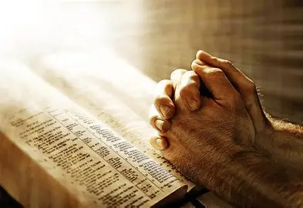
The Lord’s Prayer
Our Father who art in heaven,
hallowed be thy name.
Thy kingdom come.
Thy will be done on earth,
as it is in Heaven.
Give us this day our daily bread,
and forgive us our trespasses,
as we forgive those who trespass against us,
and lead us not into temptation,
but deliver us from evil.
Amen
The Lord's Prayer is the most perfect of prayers.... In it we ask, not only for all the things we can rightly desire, but also in the sequence that they should be desired. This prayer not only teaches us to ask for things, but also in what order we should desire them. The Catholic Catechism

Slide 5
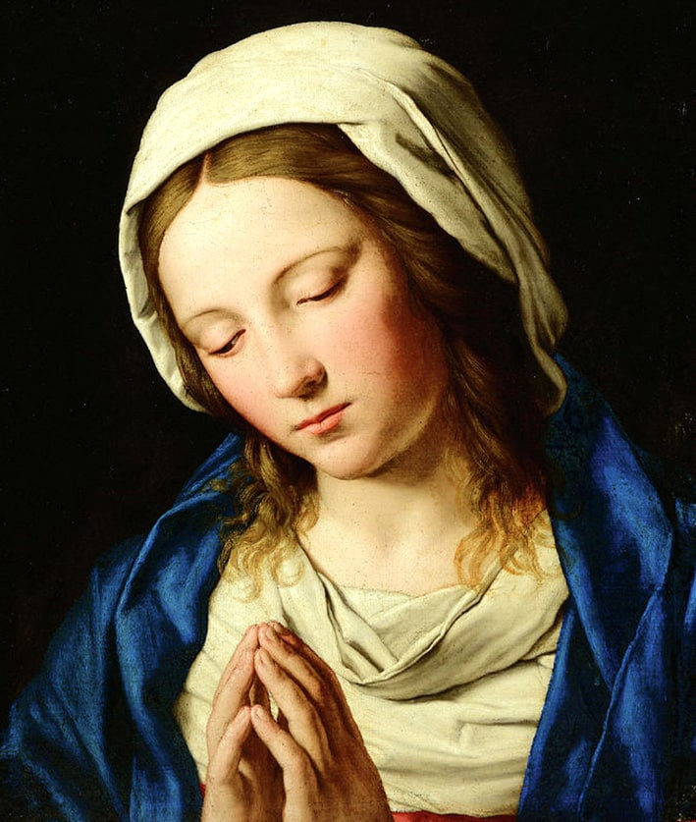
The Hail Mary
Hail, Mary, full of grace,
the Lord is with thee.
Blessed art thou among women
and blessed is the fruit of thy womb, Jesus.
Holy Mary, Mother of God,
pray for us sinners,
now and at the hour of our death.
Amen.
"Hail, full of grace, the Lord is with you!“ This greeting, known as the Angelus, forms the foundation of the opening line of the Hail Mary. Gabriel's words are significant because they recognize Mary's unique role in salvation history as the one chosen to be the Mother of God, and they affirm her sinless nature as "full of grace."

Slide 6
School Prayer
God our Father, we ask you to walk by our side, hand in hand,
helping us to make our school a kind and respectful place.
Guided by Mary, teach us to show love,
gentleness and appreciation to each other.
Encourage us to use our gifts responsibly and
learn from our mistakes, so we can make the world a richer place.
By loving You, loving each other and loving ourselves,
inspire us to bring Jesus’ message of love and forgiveness to others,
through our words and our actions.
Amen
St Mary, Mother of God, pray for us

Slide 7
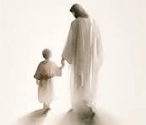
Morning Prayer
Good morning, dear Jesus,
During this day,
Be my companion,
At work and at play.
Amen
Prayer in the morning is often about the praise of God, the wonders of the new day and God’s creation, and looking ahead to the day with trust in God’s guidance. Prayer and Liturgy Directory

Slide 8
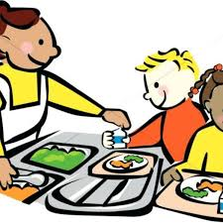
Grace before Meals
EYFS/KS1
Lord we are so grateful, for every cup and plateful. Forgive us if we are wasteful, our Lord and Family
Whole School
Bless us, O God, as we sit together. Bless the food we eat today. Bless the hands that made the food. Bless us, O God.
KS2
We thank you God, We thank you God For all our food, For all our food We thank you God for all our food. We thank you God for lunch and dinner. We thank you God for all our food! Amen! Amen!

Slide 9

Grace after meals
Thank you, God, for the food we have eaten. Thank you, God, for all our friends. Thank you, God, for everything. Thank you God.
Amen

Slide 10
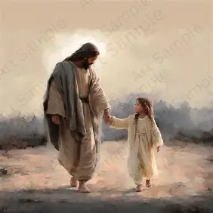
End of the Day Prayer
God, our Father, I come to say thank you
for your love today. Thank you for my
family and all the friends you give to me.
Guard me in the dark of night and in the
morning send your light.
Amen.
Prayer in the evening is a time of thanksgiving for what God has done for us, a reflection on the day, and a placing in God’s hands of our troubles and concerns. Prayer and Liturgy Directory

Slide 11
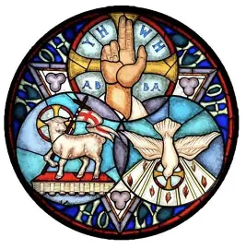
Glory be to the Father
Glory be to the Father
and to the Son
and to the Holy Spirit,
as it was in the beginning
is now, and ever shall be
world without end. Amen.

Slide 12

Trust prayer
God Our Father,
Give us strength so that, guided by Our Lady’s example, we can have the courage to say yes to you. Help us to love like she loved, have faith like she had and follow Jesus’ example in all that we do.
Inspire in all of us a sense of togetherness, so that we can use the gifts you have given us for the good of all in our community and bring support and healing to those less fortunate than ourselves.
We ask Our Lady to guide us, just as she guided St Bernadette, as we seek to bring Jesus’ message of love and forgiveness to others.
We ask this through Jesus Christ, your Son, Our Lord.

Slide 13
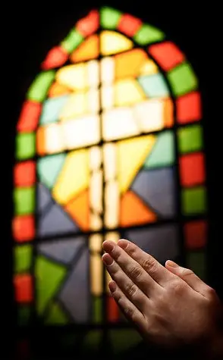
Act of Contrition
O my God,
because you are so good,
I am very sorry that I have sinned against you,
and with the help of your grace
I will not sin again.
One of the forms of the Penitent’s Prayer of Sorrow found in the
Rite of Penance

Slide 14
The Apostles’ Creed
I believe in God, the Father almighty
Creator of heaven and earth,
and in Jesus Christ, his only Son, our Lord,
(At the words that follow, up to and including the Virgin Mary, all bow.)
who was conceived by the Holy Spirit,
born of the Virgin Mary,
suffered under Pontius Pilate,
was crucified, died and was buried;
he descended into hell;
on the third day he rose again from the dead;
he ascended into heaven,
and is seated at the right hand of God the Father almighty;
from there he will come to judge the living and the dead.
I believe in the Holy Spirit,
the holy catholic Church,
the communion of saints,
the forgiveness of sins,
the resurrection of the body,
and life everlasting. Amen.
Based on baptismal documents of the 8th century but related to texts of an earlier origin.

Slide 15
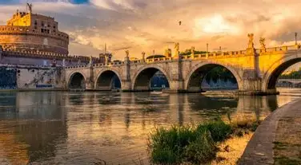
Angel of God
Angel of God,
my guardian dear,
to whom God’s love commits me here,
ever this day be at my side,
to light and guard, to rule and guide.
Amen
The prayer is based on one by Reginald of Canterbury in the early 12th century.

Slide 16
Come, Holy Spirit
V. Come, Holy Spirit, fill the hearts of your faithful.
R. And kindle in them the fire of your love.
V. Send forth your Spirit and they shall be created.
R. And you will renew the face of the earth.
Let us pray
O God, who by the light of the Holy Spirit,
did instruct the hearts of your faithful,
grant that by that same Holy Spirit,
we may be truly wise, and ever rejoice in your consolation,
Through Christ our Lord. Amen.
This prayer is a compilation of a number of liturgical texts drawn from the Mass and Office of Pentecost and the Votive Mass of the Holy Spirit

Slide 17
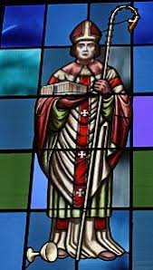
Prayer of St Richard of Chichester
Thanks be to you, my Lord Jesus Christ,
for all the benefits which you have given me,
for all the pains and insults which you have borne for me.
O most merciful Redeemer, friend and brother,
may I know you more clearly,
love you more dearly,
and follow you more nearly,
day by day.
Amen.

Slide 18
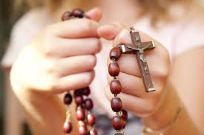
The Rosary
For each mystery or decade, one Our Father, ten Hail Marys and the Glory be is recited.
The Joyful Mysteries (Recited Monday and Saturday)
The Mysteries of Light (Recited Thursday)
The Sorrowful Mysteries (Recited Tuesday and Friday)
The Glorious Mysteries (Recited Wednesday and Sunday)

Slide 19
The Rosary
Prayer concluding the Rosary [Hail, Holy Queen]
V. Pray for us, O holy Mother of God.
R. That we may be made worthy of the promises of Christ.
Let us pray.
O God, whose only-begotten Son,
by his life, death and resurrection,
has purchased for us the rewards of eternal life,
grant, we beseech thee,
that meditating on these mysteries
of the most holy Rosary of the Blessed Virgin Mary,
we may imitate what they contain
and obtain what they promise,
Through the same Christ our Lord. Amen.

Slide 20
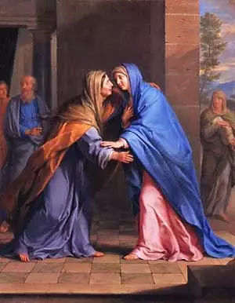
The Magnificat
My soul proclaims the greatness of the Lord,
and my spirit rejoices in God my Saviour,
for he has looked upon his handmaid in her lowliness;
for behold, from this day forward, all generations will call me blessed.
For the Almighty has done great things for me,
and holy is his name.
His mercy is from age to age for those who fear him.
He has made known the strength of his arm,
and has scattered the proud in their conceit of heart.
He has cast down the mighty from their thrones
and has exalted those who are lowly.
He has filled the hungry with good things,
and has sent the rich away empty.
He has helped his servant Israel,
mindful of his mercy,
even as he promised to our fathers, to
Abraham and his descendants for ever.
Glory be to the Father and to the Son
and to the Holy Spirit,
as it was in the beginning, is now,
and ever shall be, world without end.
Amen.
Mary’s song of praise was first sung to her cousin Elizabeth (Luke 1:46–55). It is sung daily at Evening Prayer

Slide 21
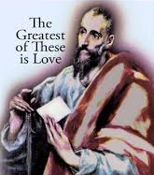
Acts of faith, hope, and love are based upon the theological virtues because they are the virtues of God. These three traditional Catholic prayers allow us to draw closer to God, and they have their foundation in God.
Act of Love
My God, because you are so good,
I love you with all my heart,
and for your sake,
I love your neighbour as myself.
St. Paul says in the 1st Book of Corinthians (1 Cor 13:13) love is the greatest of the three. Love, like God, is eternal and lasts forever.

Slide 22
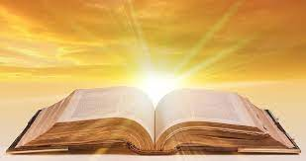
Act of Faith
My God, I believe in you
and all that your Church teaches,
because you have said it,
and your word is true.
In the Act of Faith prayer, we profess the light of the Gospel.

Slide 23
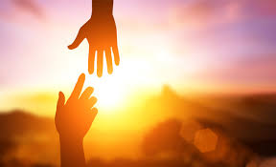
Act of Hope
My God, I hope in you,
for grace and for glory,
because of your promises,
your mercy and your power
The Act of Hope prayer directs our focus on God to be our hope. We hope in His mercy to help get us through life’s battles and storms, and we hope for eternal life with Him.

Slide 24
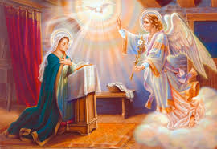
The Angelus
V. The Angel of the Lord declared unto Mary.
R. And she conceived of the Holy Spirit.
Hail, Mary, full of grace, the Lord is with thee.
Blessed art thou among women,
and blessed is the fruit of thy womb, Jesus.
Holy Mary, Mother of God,
pray for us sinners,
now and at the hour of our death.
Amen.
V. Behold the handmaid of the Lord.
R. Be it done unto me according to thy word.
Hail Mary.
V. And the Word was made flesh.
R. And dwelt among us.
Hail Mary.
V. Pray for us, O holy Mother of God.
R. That we may be made worthy of the promises of Christ.
Let us pray;
Pour forth, we beseech thee, O Lord,
thy grace into our hearts;
that we, to whom the Incarnation of Christ, thy Son,
was made known by the message of an angel,
may by his Passion and Cross be brought to the glory of his Resurrection.
Through the same Christ, our Lord.
Amen.
The Angelus is traditionally said three times a day: at 6am, 12 noon, and 6pm.

Slide 25
